Slide 1
Project eVolby An Electronic voting system for the Academic Senate
A project for SI2 a SI3
Tomáš Čerevka, Honza Zahula, Pavel Valenta, Rado Murin

Slide 2

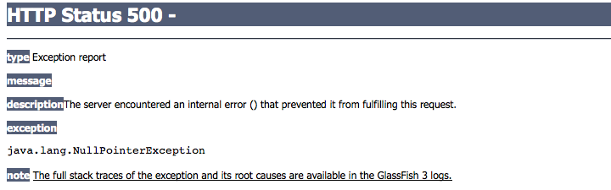
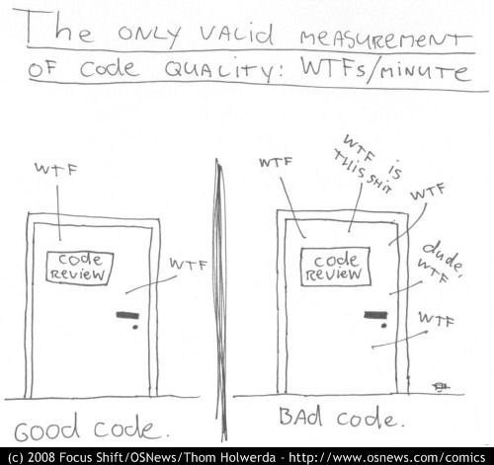


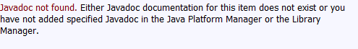
What we recieved

Slide 3
What we recieved
A lot of actions created server Errors due to bad tutorials for deployment
Bulky login with redundant choices
Very little javadoc
Analysis and design not complete and inconsistent with actual implementation
Slow loading applet with bugs, little functionality and inexplicable size
Simple and insufficient voting results
Security not implemented at all
No testing

Slide 4
What we achieved
The user no longer needs to select his role prior to login (less redundancy)
JUnitTest implemented where possible
Selenium Tests created to test the user interface
The system now distinguishes between voter types
Creation of a new security system – more info later on
JavaDoc is used on most of the methods in the source code
New tutorial written to ease up deployment

Slide 5
What we achieved
It is no longer possible to vote and nominate at the same time (security enhancement)
User actions are now confirmed with confirmation dialogues
The JavaFX applet has been rewritten from scratch and is now lighter and faster (not yet fully functional)
Decided to go for a web election for the academic senate

Slide 6


Privileged actions explained
Other commissioners
Confirmation
Commissioner wishes to end nomination (action requiring priviledge)
Email notification sent
Success / Rejection

Slide 7
Future plans – 14 days
Email notifications not implemented
Final result generator – it will properly decide according to the rules who has been elected, who is the substitute and who has lost
Timed election events - commissionaires will no longer have to start and end the election event manually the system will provide a service for that (may be postponed to a later date)
Bettering of the analysis and design documents
Creation of documents specified in SI2 and SI3

Slide 8
Thank you for your attention
http://code.google.com/p/evolby/
eVolby team ZS2010

